Slide 1
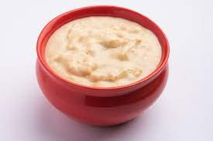
Project on entrepreneurship DEVELOPMENT OF SWEET CURD PLANT Khane ke baad only organic sweet curd Itaberia : Purba Medinipur: west Bengal: pin-721456
PROJECTED BY:
NABADIP MAITY
B. Voc (Food Processing, 6th sem)
Dept .of Nutrition
Mugberia Gangadhar Mahavidyalaya
GUIDED BY:
DR.APURBA GIRI (Assistant Professor and HOD)
AYAN MANDAL (Assistant Professor)
Dept .of Nutrition
Mugberia Gangadhar Mahavidyalaya

Slide 3
INTRODUCTION:
Business is any economic activity that includes the purchase or sale of goods or services with the basic objective of earning profit and satisfying the individuals' needs of the society.
Business activities can be classified into two categories: Industry and Commerce.

Slide 4
WHY I STARTED THE BUSINESS:
Be your own boss
Define your job description
Turn your passion into profit
Increase your earning potential
Improve the lives of others
Learn to fail and learn from your failures
Become an expert

Slide 5
MARKET SURVEY:
You must research to decide exactly what the public is interested in. This will also help you know if the frozen Sweet curd business will sustain itself in your region.
One of the keys to success in any business is presuming out what customers desire and how they require it and providing it to them the way they assume is the perfect plan.
During your research, you may explore some fascinating data that will help raise your business.
Perhaps there is untouched demand for definite varieties of frozen sweet curd for example lactose-free frozen sweet curd or frozen sweet curd made with local, free-range milk.

Slide 6
LOCATION CHOSE:
In order to select the location, you must consider the area where you want to open the sweet curd industry.
You should go to the city, suburban, and rural area but make sure you should choose the pollution free area.
You should also make a rough plan and estimation of your spending. Because sweet card industry requires so much money and investment in order to make the building.
You need more money to buy bricks, cement, and some other things which are necessary to make the building.

Slide 7
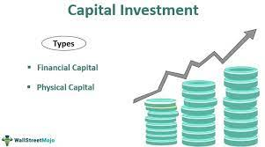
INVESTMENT:
CAPITAL 40-50 LAKHS

Slide 8
LICENCE:
Business Entity
FSSAI registration
Trade License
Udyog Aadhaar Registration
GST Registration
BIS certification
No Objection Certificate From State Pollution Control Board

Slide 9
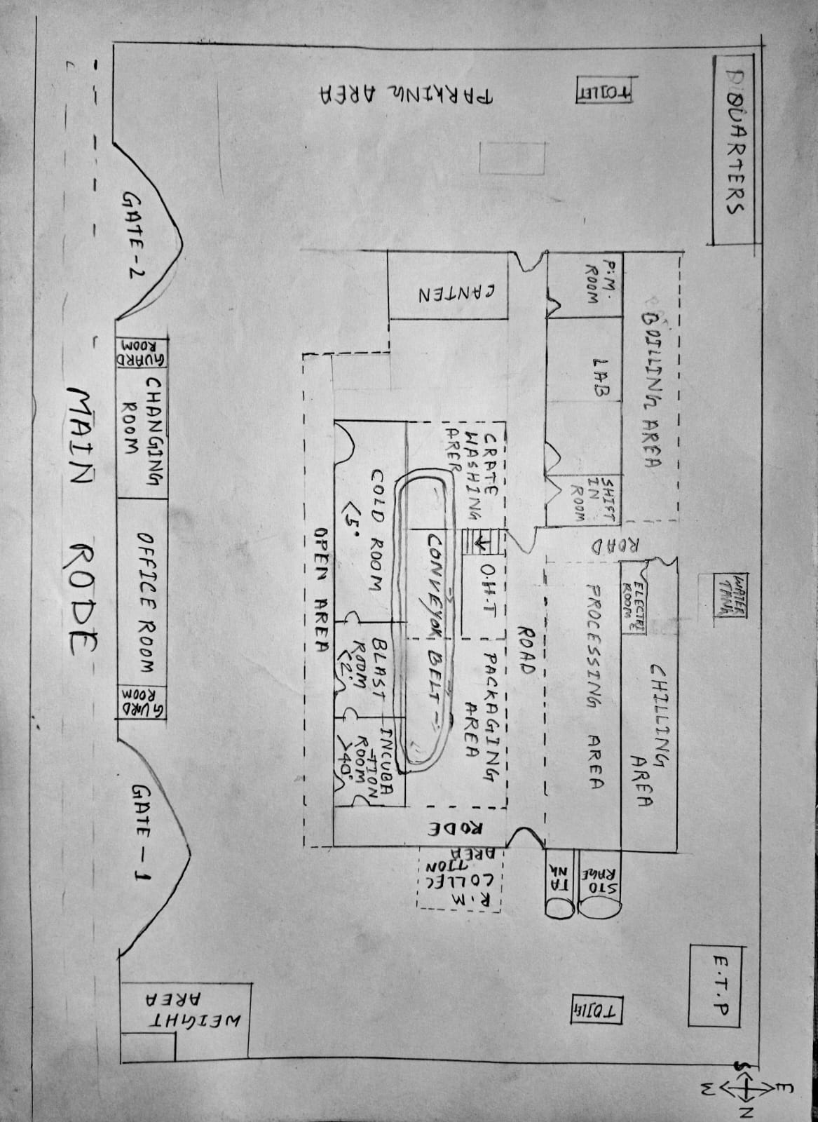
LAYOUT:
35000-40000 SQ.FT
.

Slide 10
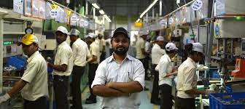
MANPOWER:
Guard- 2
Weighting area-1
Lab-4
Processing-3
Packaging-2
Store-2
Washing-3
Boiler section-2
Chilling section-2
ETP-1
Shift incharge-2
Data documentation-1
Electrician-2
Overall manegment-1
25-30 LABOURS

Slide 11
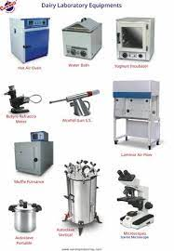
EQUIPMENT:
Milk Storage tank/silo
Motor
Pasteurizer
Pasteurizer holding tube
Packaging machine
Gerber centrifuge
Lactometer
Thermometer
Refrigerator
Weight machine
water bath
Hot air oven

Slide 12
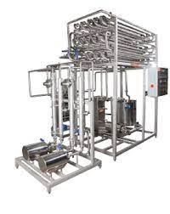
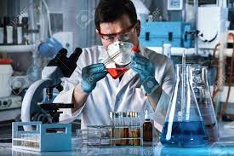
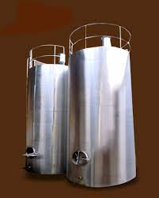
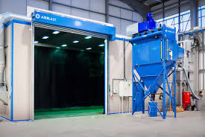
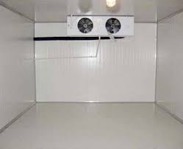
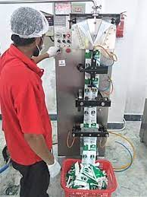
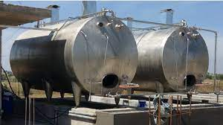
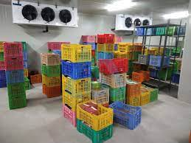
FLOW CHART:
.
Pasteurized milk
Test
Holding tube
Culture added
Blast room
Incubation room
Packaging
Storage tank
Cold room

Slide 13
LABORATORY TEST:
pasteurized milk test for sweet curd making:
FAT TEST
CLR TEST
SNF TEST
ACIDITY TEST
ALCOHOL TEST
MBRT TEST
POUCH QUALITY TEST

Slide 14
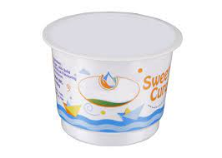
PRODUCTS DETAILS:
.
100gm
MRP-15
250gm
MRP-35
500gm
MRP-68
1kg
MRP-130

Slide 15
BUSINESS RESEARCH:
Demand
Supply
Price
Quality
Quantity

Slide 16
MARKET STRATEGY:
Publicity
Advertising
Sales promotion
Direct marketing
Special discount

Slide 17
TARGET COUSTOMER BEING:
Sweets shops
Hotels and restaurants
Marriage and functions
Wholesalers

Slide 18
CONCLUSION:
A business plan conclusion is a summary of a business plan's strengths designed to convince the reader of the company's success.
Because companies typically create business plans to get funding or investors, the conclusion should focus on how the organization makes money and why it is a good investment.

Slide 19
Thank you
.

